Slide 1
Asset Allocation
Assignment 2019
Alix de Sarrazin - Bijan Sadat - Johan Monnard - Oleksii Myronko - Torgeir Holmen
May 16th, 2019

Slide 2

A
GENDA
1
Data & Summary Statistics
2
Real Estate Role in a Portfolio
Portfolio Construction under OPP2 Constraints
3
4
Comparison & Results
5
Currency Risk Hedging

Slide 3
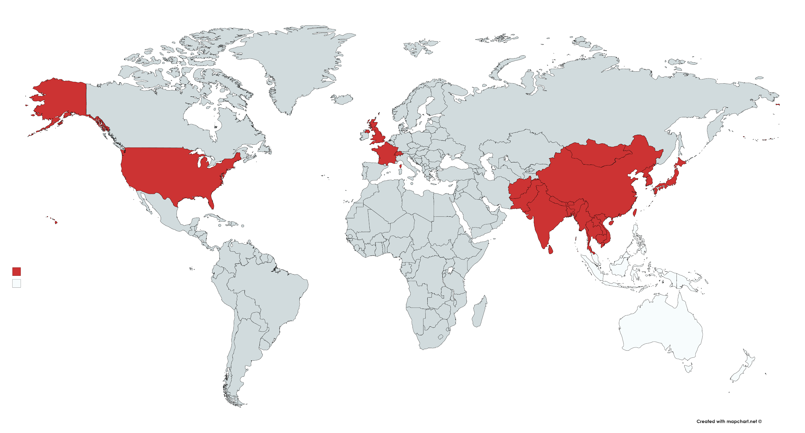
Data & Summary Statistics
1
1. Data
1
Dataset of quarterly total returns from Jan 1999 until March 2019 ( 20.25 years)
Extracted from Bloomberg
Major stocks indices : SMI20, S&P500, CAC40, FTSE100
Bonds (Aggregate US and CH GOV bonds)
Listed NAREIT from USA,UK,CH,FR,ASIA
Direct Swiss Real Estate, SWX IAZI
Notes:
SMIMC Index
SPTR500N Index
CACR Index
TUKXG Index
LD08TRUU Index
SBIDGT Index
Bloomberg Barclays US Aggregate: Government-Related Total Return Unhedged USD
Swiss Bond Index (SBI) Domestic Government Total Return
FTSE EPRA/NAREIT United States Index Net TRI USD
FTSE EPRA/NAREIT UK REITs TR GBP
FTSE EPRA/NAREIT Switzerland Index Net TRI
FTSE EPRA/NAREIT France Index Net TRI
FTSE EPRA/NAREIT Developed Asia in USD
Suggestions: Summarize all indices used - From where they have been collected (Bloomberg) - Time frame - quarterly - Performance index not price => explain why
Try to find a nice display such as this image, where you could colored the country used for our assignment (not to have only text on the slide)

Slide 4
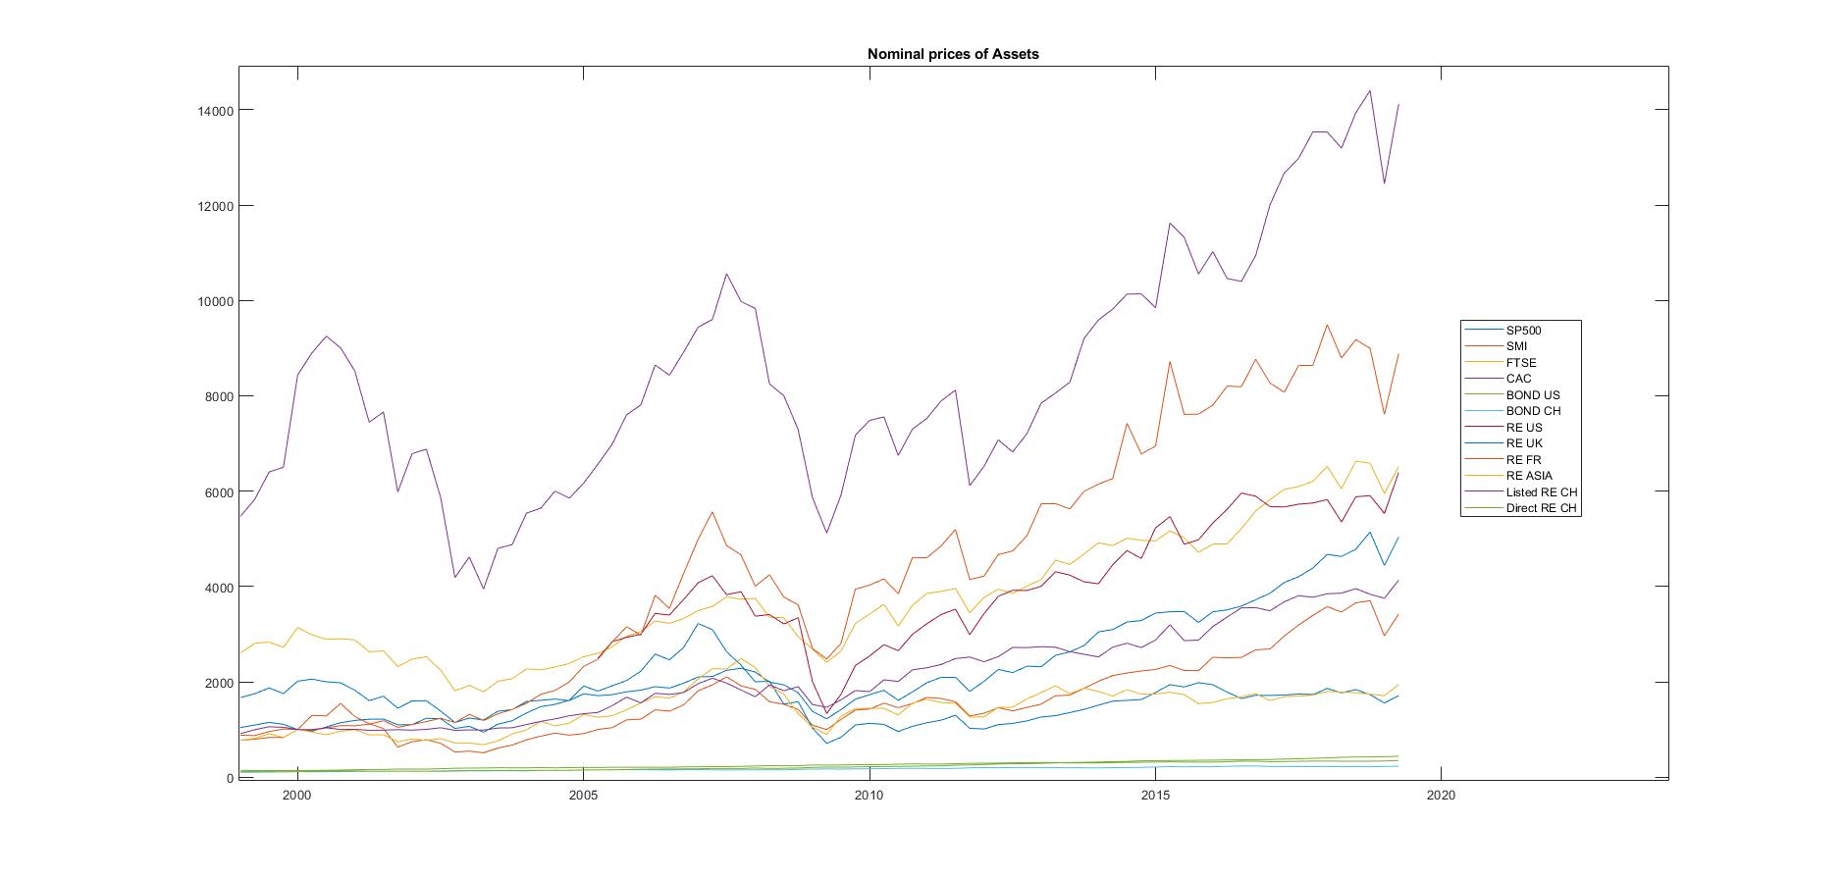
Data & Summary Statistics
1
2. Summary Statistics - (Nominal) Price Evolution
1

Slide 5
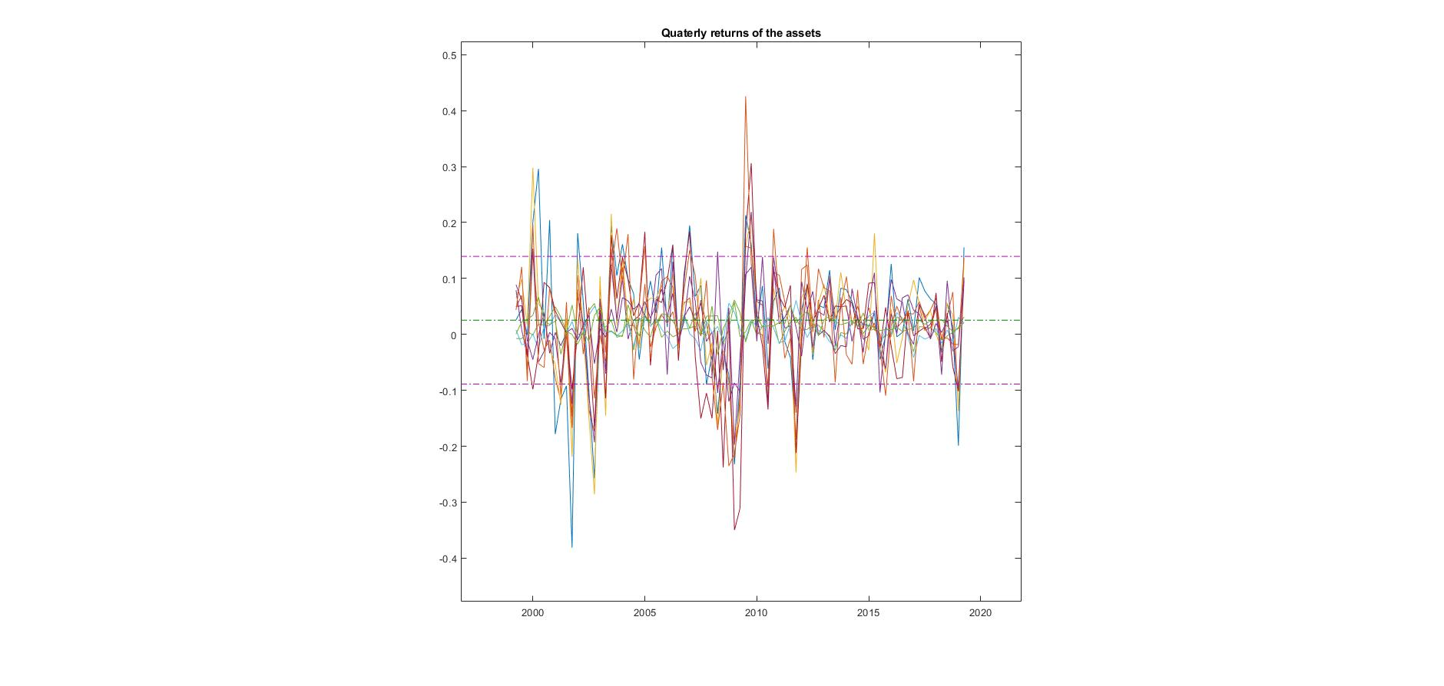
Data & Summary Statistics
1
3. Summary Statistics - Quarterly asset returns
1
Mean | 2.527%
Median | 3.681%
Standard deviation | 11.41%

Slide 6
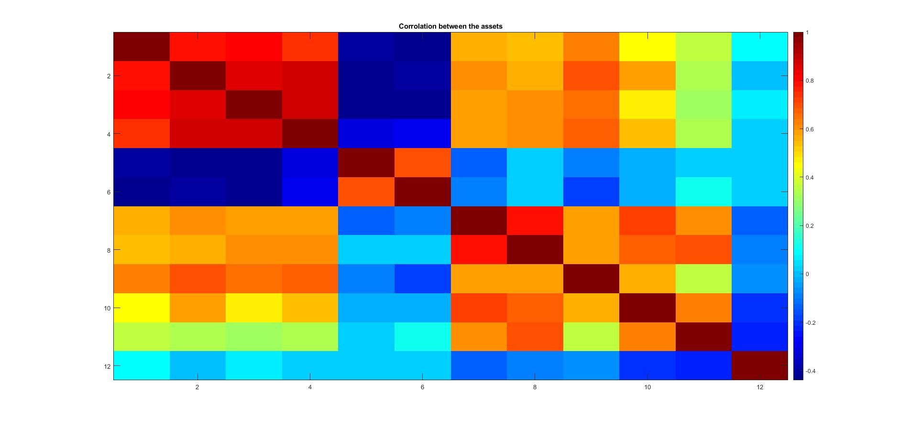
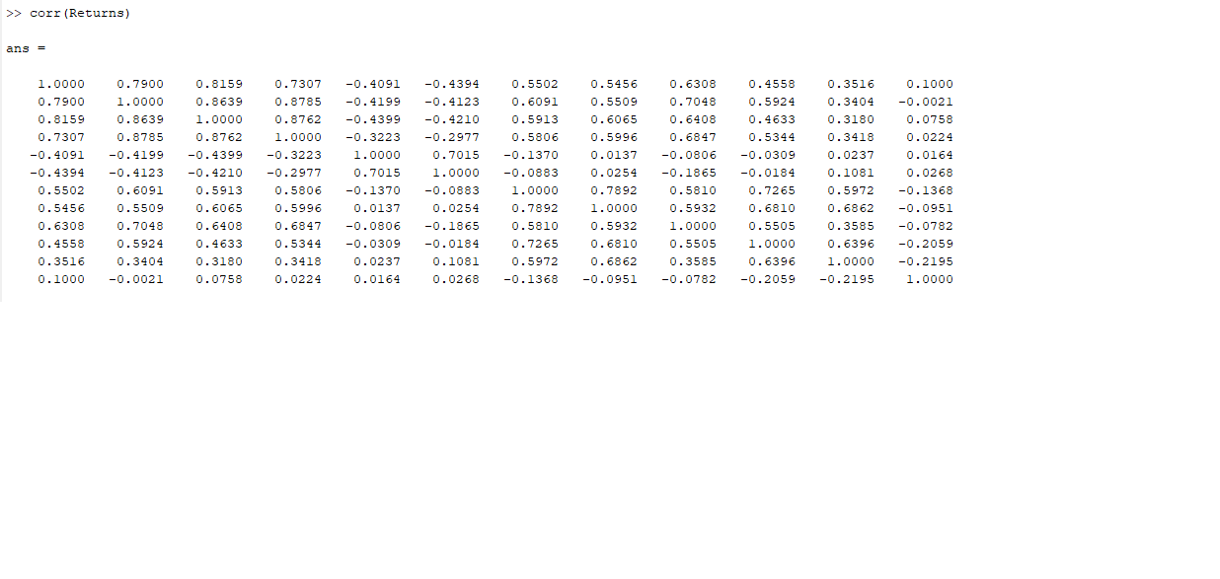
Data & Summary Statistics
1
4. Summary Statistics - Correlation of the returns
1

Slide 7
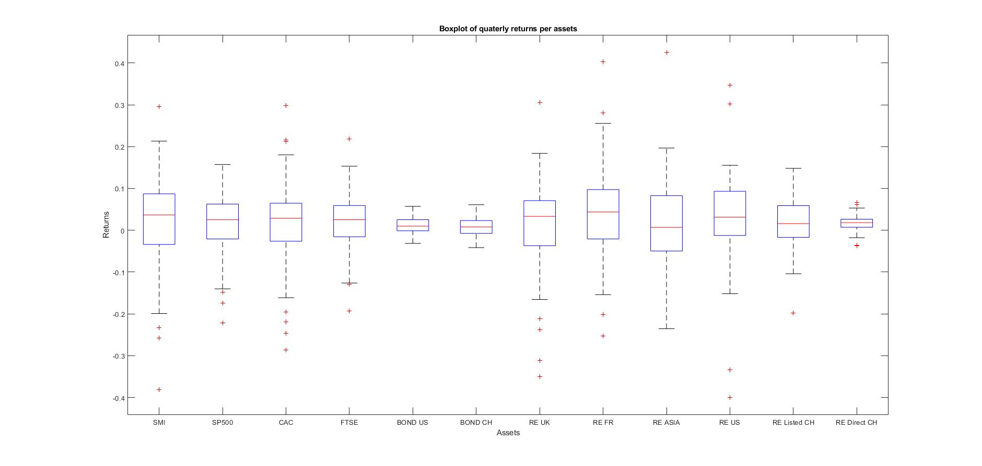
Data & Summary Statistics
1
1

Slide 8
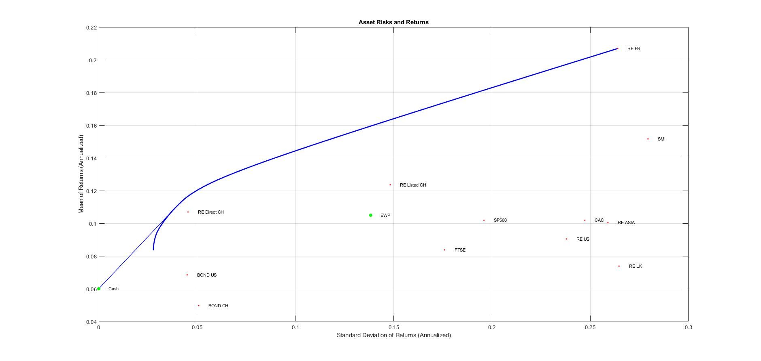
Real Estate Role in a Portfolio
2
1. Portfolio (All assets)

Slide 9
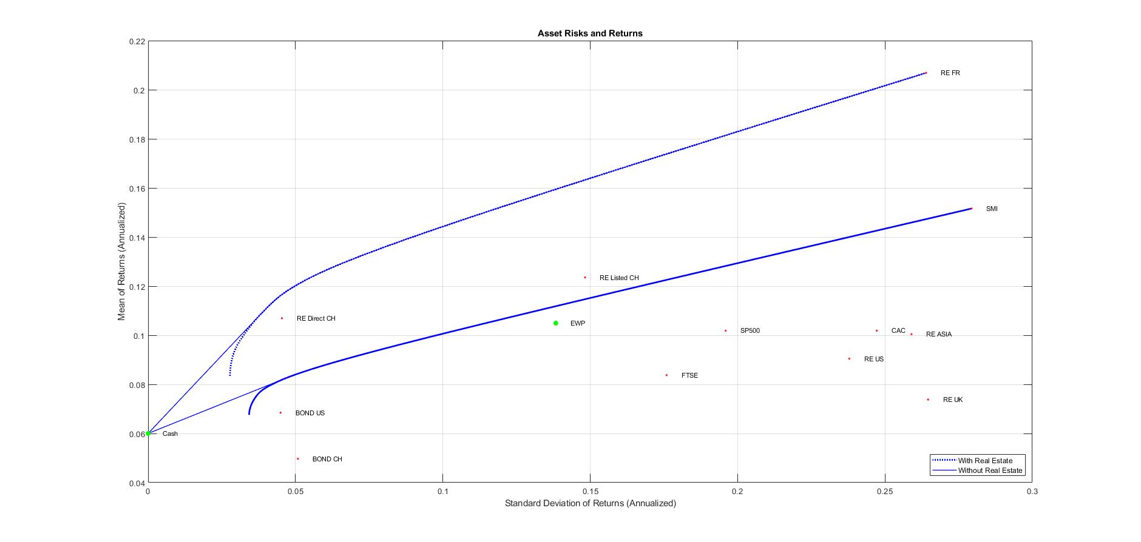
Real Estate Role in a Portfolio
2
3. Efficient frontier (No RE)

Slide 10
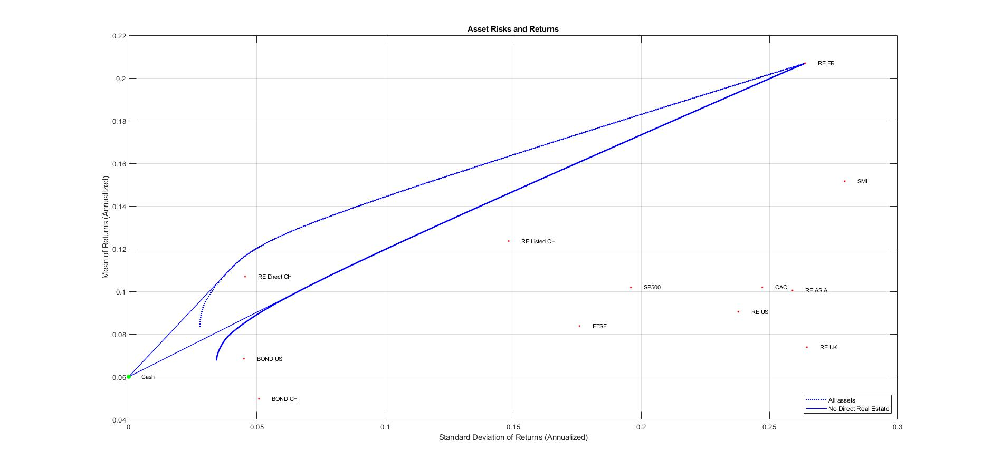
Real Estate Role in a Portfolio
2
2. Portfolio without Direct RE

Slide 11
Portfolio Construction under OPP2 Constraints
3
1. Relevant Articles
Art 50 al 3 & Art 52 - Specific requirements
Risk allocation
Time horizons
Liquidity
Art 54b al 1 - Real Estate Requirements
Max 5% of total fund wealth per property
Art 53 - Authorized investments
Cash amounts
Stocks
Bonds
Property
Participation certificates
Alternative investments
Art 55 - Allocation weight limits
50% in stocks
Between 15-30% for other asset classes
30% in real estate (maximum of 1/3 abroad)
Art 53 al. 5 - Leverage
Stocks and bonds : not allowed
Real estate : refer to art. 54b al.2; Max 30% of property’s market value on external financing

Slide 12
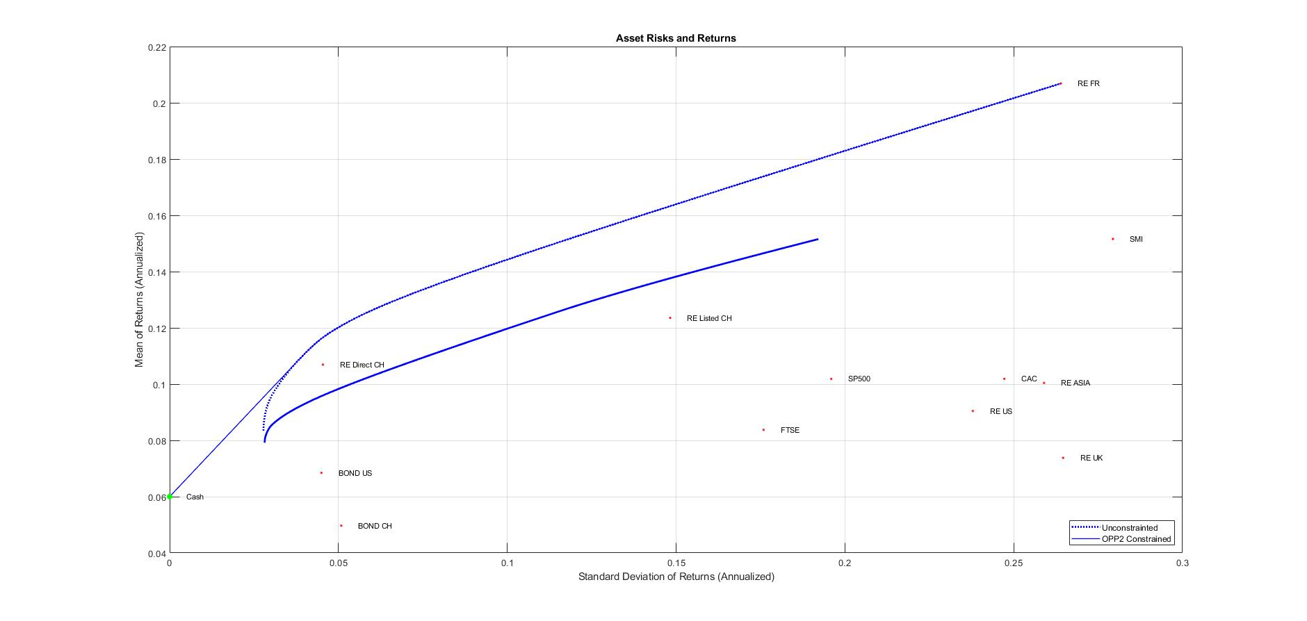
Portfolio Construction under OPP2 Constraints
3
2. Efficient Frontier under OPP2 Constraints

Slide 13
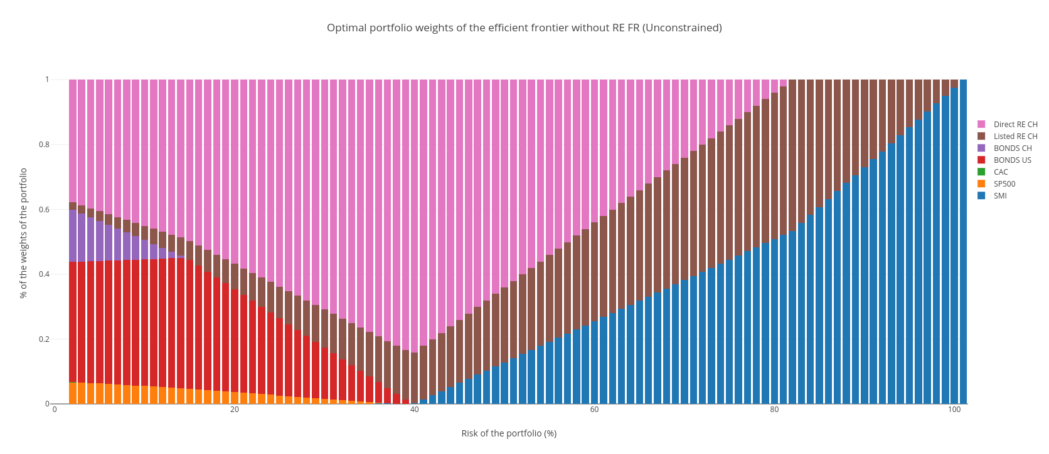
Optimal portfolio weights
3
2. Efficient weights unconstrained
Notes:
https://plot.ly/~BijanSN/18/#/

Slide 14
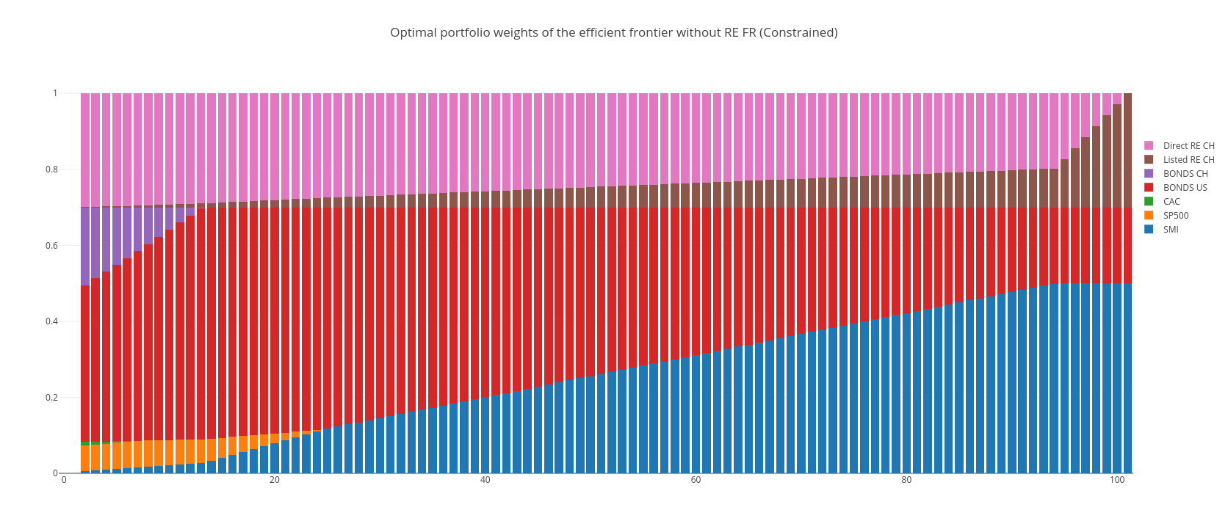
Optimal portfolio weights
3
2. Efficient weights constrainted
Notes:
https://plot.ly/~BijanSN/15/#/

Slide 15
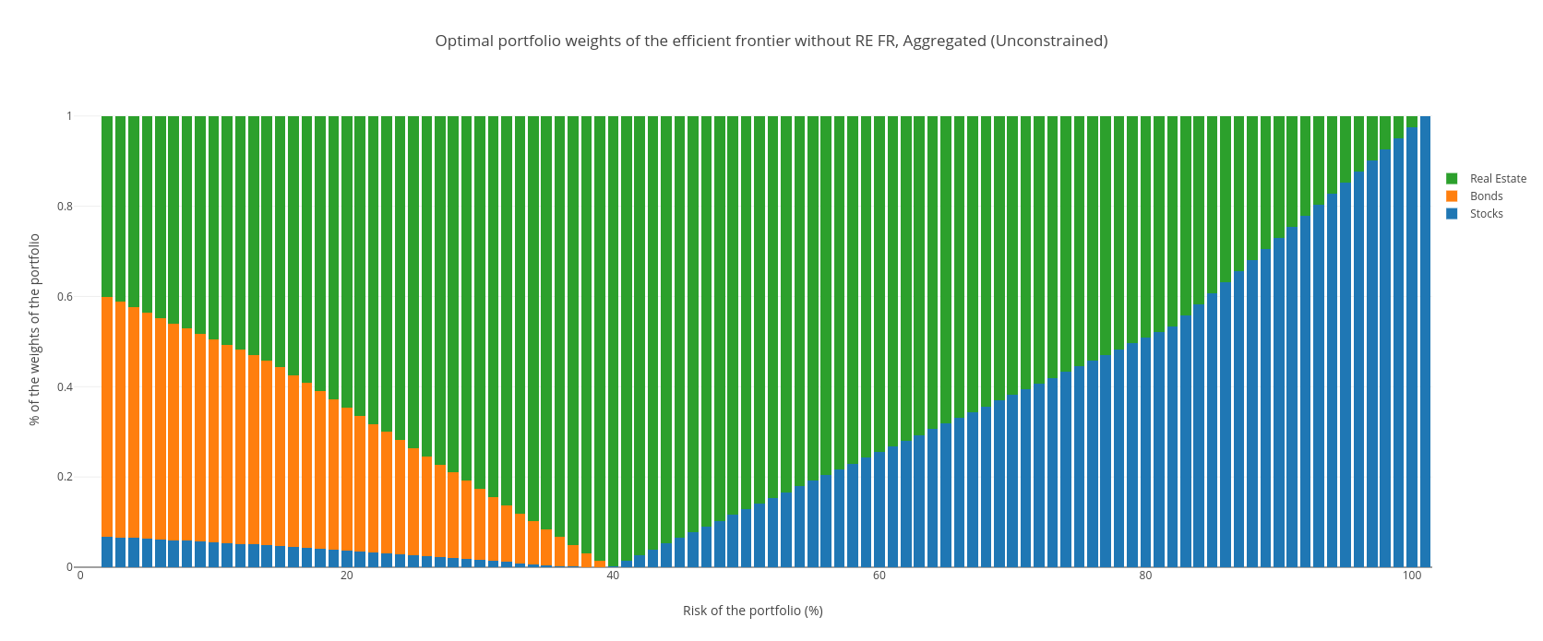
Optimal portfolio weights
3
2. Efficient weights unconstrainted (aggregated by asset class)

Slide 16
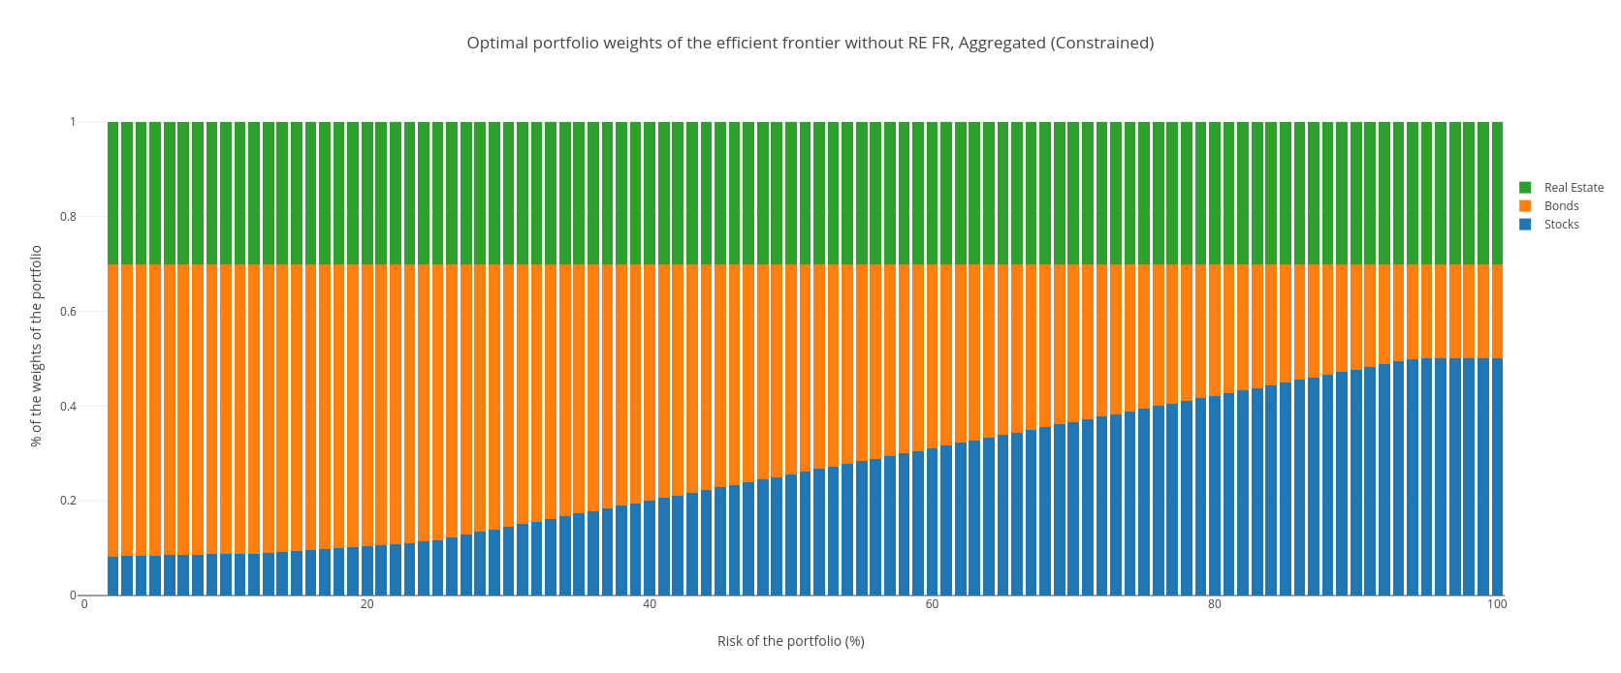
Optimal portfolio weights
3
2. Efficient weights unconstrainted (aggregated by asset class)

Slide 17
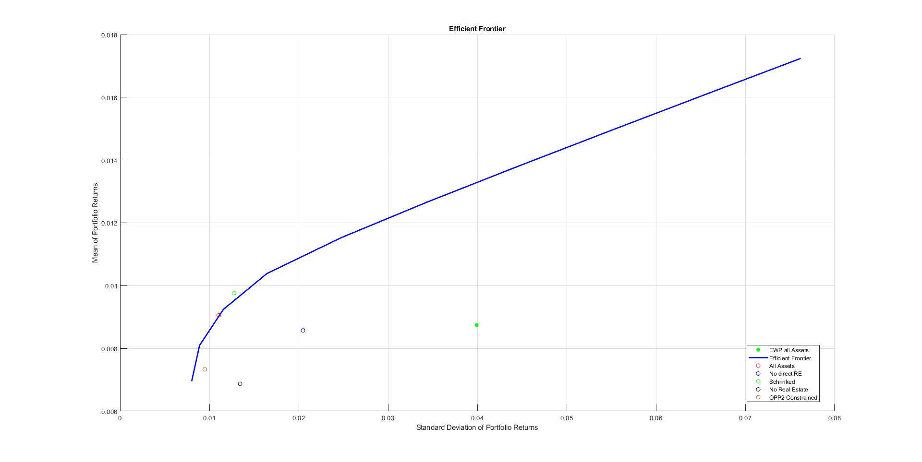
Comparison & Results
4
1. Summary: All cases comparison
Notes:
Suggestions: Comparison; without RE ; with Listed only ; with Listed + Direct; Constrained

Slide 18
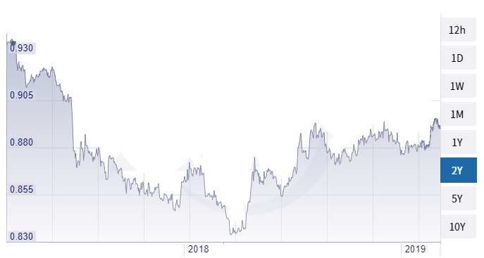


Currency Risk Hedging
5
1. CHF/EUR Example

Slide 19

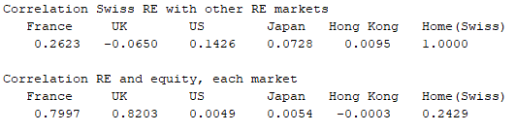
Currency Risk Hedging
5
2. Swiss Real Estate Sector Framework
85% domestic investment
Attractive investment, particularly high-end (PwC, Julius Baer, UBS)
Biggest foreign investors: UK and Euro-Zone countries

Slide 20

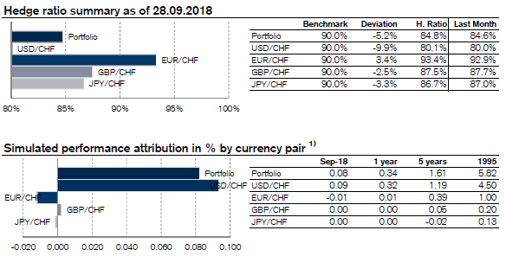
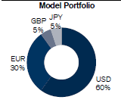
Currency Risk Hedging
5
3. Credit Suisse Case Analysis

Slide 21
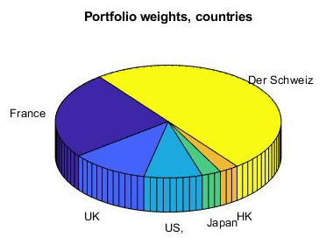
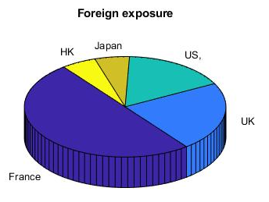
Currency Risk Hedging
5
4. Hypothetical Portfolio Simulation

Slide 22
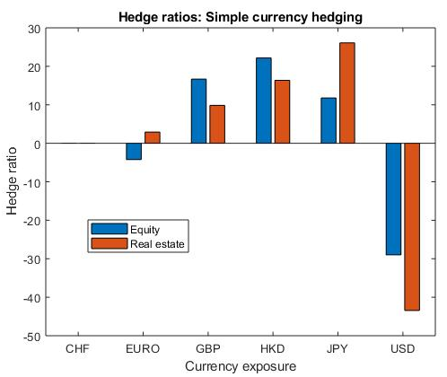
Currency Risk Hedging
5
5. Hedge Ratios - Simple Currency Hedging
Regress portfolio returns on the currency excess return of each market.

Slide 23
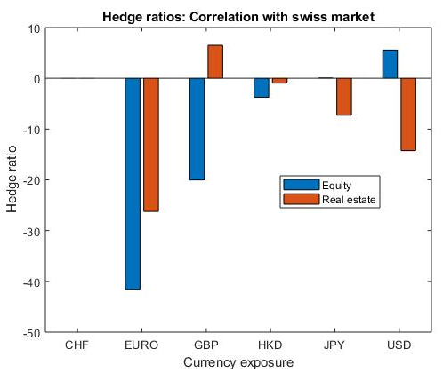
Currency Risk Hedging
5
5. Hedge Ratios - Correlation with Swiss Market
Regress the swiss market on each foreign market.
Use these betas to construct the currency portfolio

Slide 24
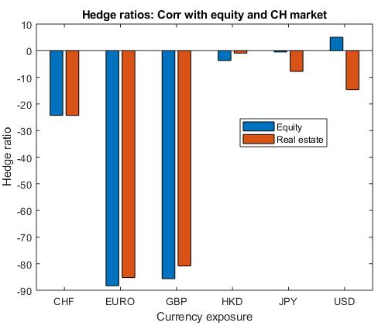
Currency Risk Hedging
5
5. Hedge Ratios - Correlation with Equity and Swiss Market
Regress real estate on equity for each country. Then geometrically add the correlation of the Swiss market with each foreign market
Use these betas to construct the currency portfolio

Slide 25
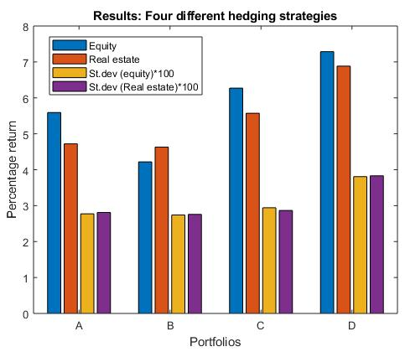
Currency Risk Hedging
5
5. Hedge Ratios - Methodology Comparison
A : Unhedged
B : Simple hedge
C : Correlation with foreign markets
D : Correlation with foreign markets and equity

Slide 26
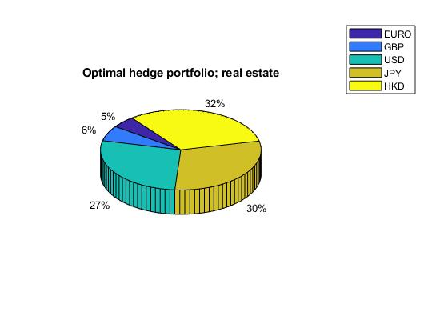
Currency Risk Hedging
5
6. Hypothetical Portfolio Simulation - Optimal Hedged Portfolio with 5 Currencies

Slide 27
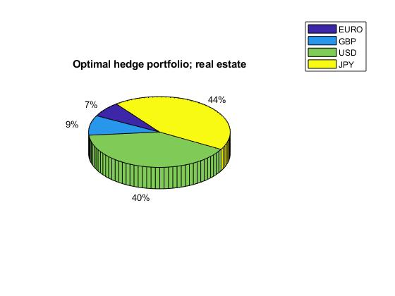
Currency Risk Hedging
5
6. Hypothetical Portfolio Simulation - Optimal Hedged Portfolio with 4 Currencies

Slide 28
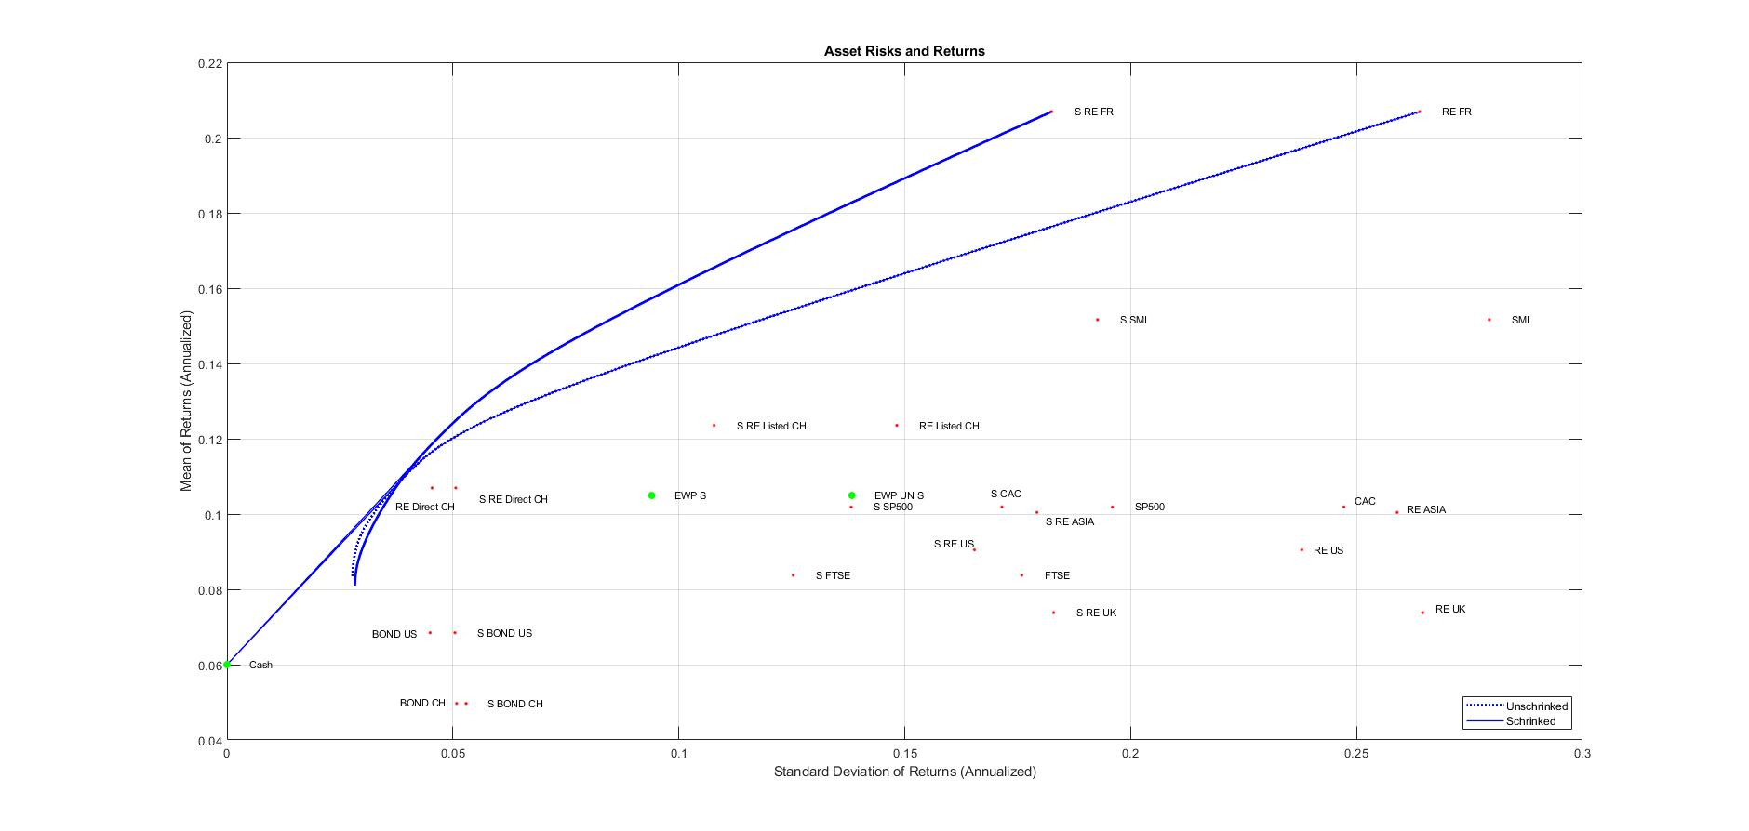
Extension : Estimation errors
6
Notes:
As well as constraint on weights, not good.

Slide 29

THANK YOU FOR YOUR ATTENTION!
Any questions ?

